Slide 1
10th Gear Auto Dealer App

Slide 2
1
Hola!
A Squad
Team members
Anas Elhadidy
David Taledo
Shubhankar Killol
Ivan Vu

Slide 3
1
App Concept
10th gear offers complete dealership inventory solution for retail auto industry. It helps to bridge gap between sales, service and marketing operation.

Slide 4
Modules
Point of sale
Inventory control
Customers Relationship management
Business Intelligence Reporting
Business expenses Control
Single Sign On Capability

Slide 5
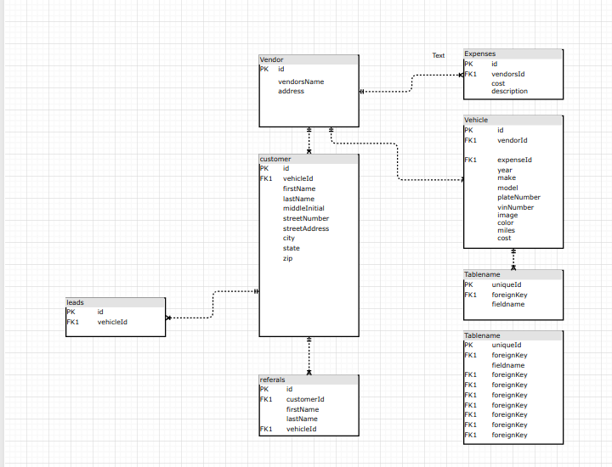
1
ERD

Slide 6
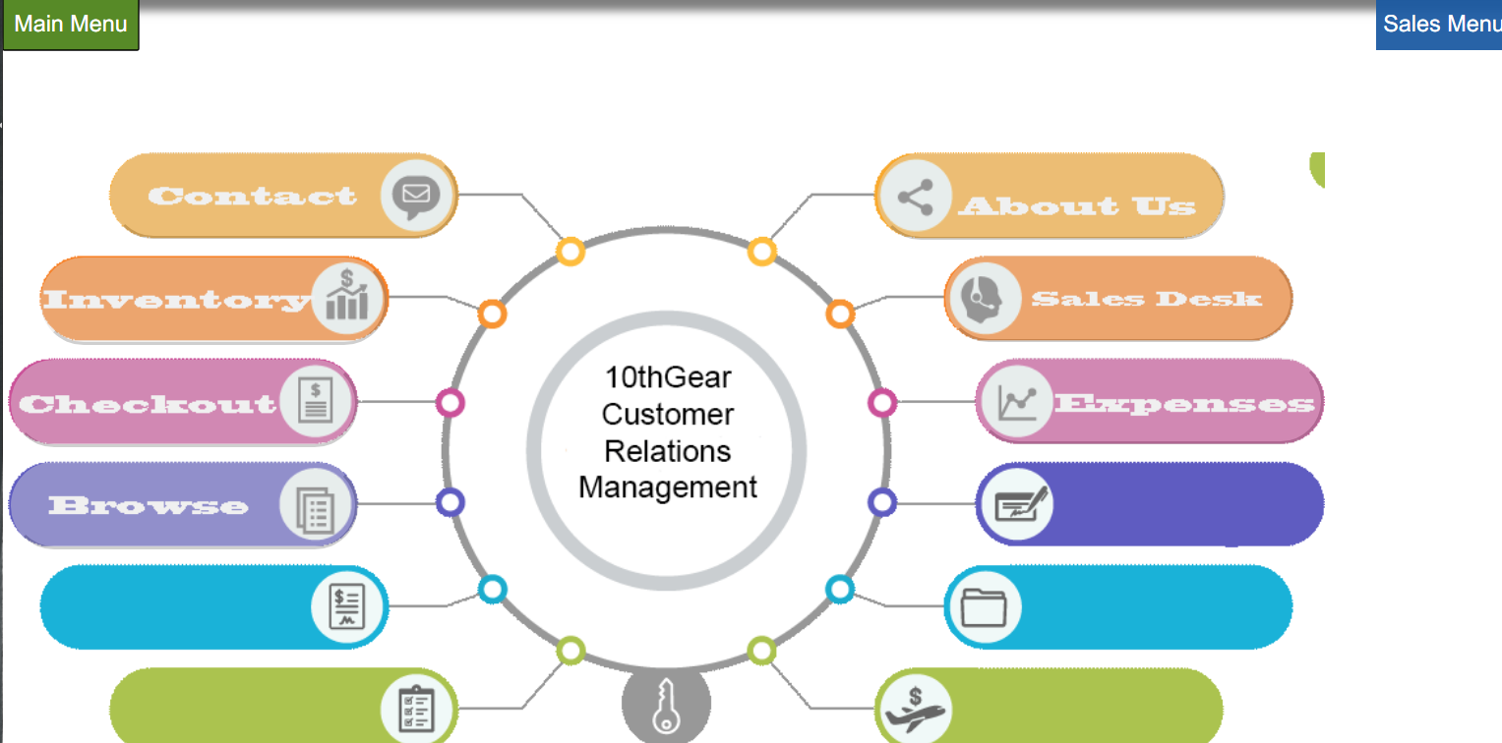

Slide 7
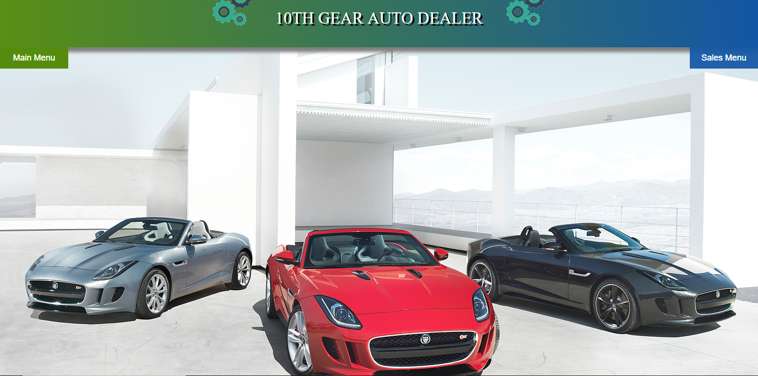
1
App home page screenshot

Slide 8
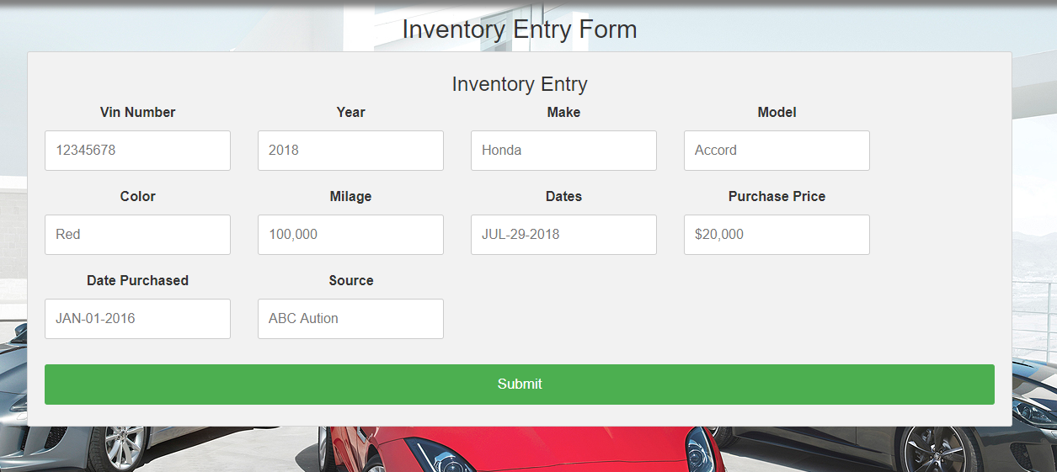
1
Inventory Entry Form

Slide 9
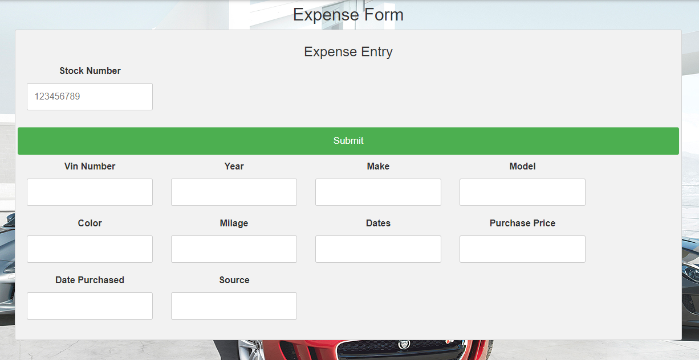
<number>
Expense Form

Slide 10
<number>
Thanks!
Any questions?

